Slide 1
Authoring Process
Stefan Meissner (Chairman Tools & Infrastructure WG)

Slide 2
Authoring Process
Design Goal:
The Creation, Modification and Extension of CIP4 Specifications have to become Open and Transparent to Everyone
Open Industry Standards live from transparent collaboration of People all over the world.

Slide 3
Concept Authoring
Idea, Suggestion
Discussion
Revision
Drafting
Implemen-tation
Authoring Process
CIP4 aims to provide a simple, transparent and straight forward Authoring Process.

Slide 4
Authoring Framework
CIP4 has introduced Atlassian JIRA: (https://jira.cip4.org)
Open and transparent Discussions
Readable for Everyone
Feature Creation and Discussion for Visitors and Members
JDF:
https://jira.cip4.org/browse/JDF
XJDF:
https://jira.cip4.org/browse/XJDF
PrintTalk:
https://jira.cip4.org/browse/PTK
Atlassian JIRA is a framework which provides an open and transparent Authoring Process.

Slide 5
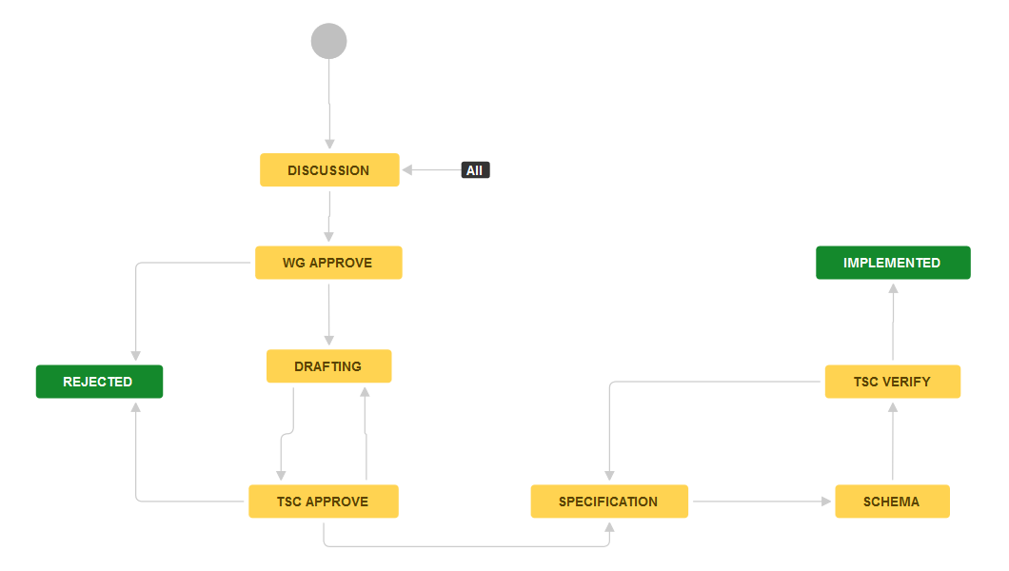
The Authoring Process
Idea, Suggestion
Implemen-tation
Discussion
Revision
Drafting

Slide 6
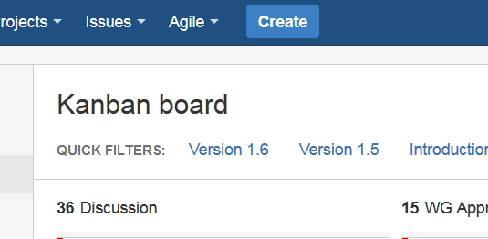
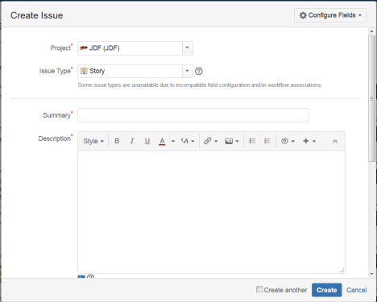
New Ideas / Suggestions
1
Click Create
2
Write Issue
You can submit new ideas and suggestions by creating a new Issue in JIRA at any time.

Slide 7
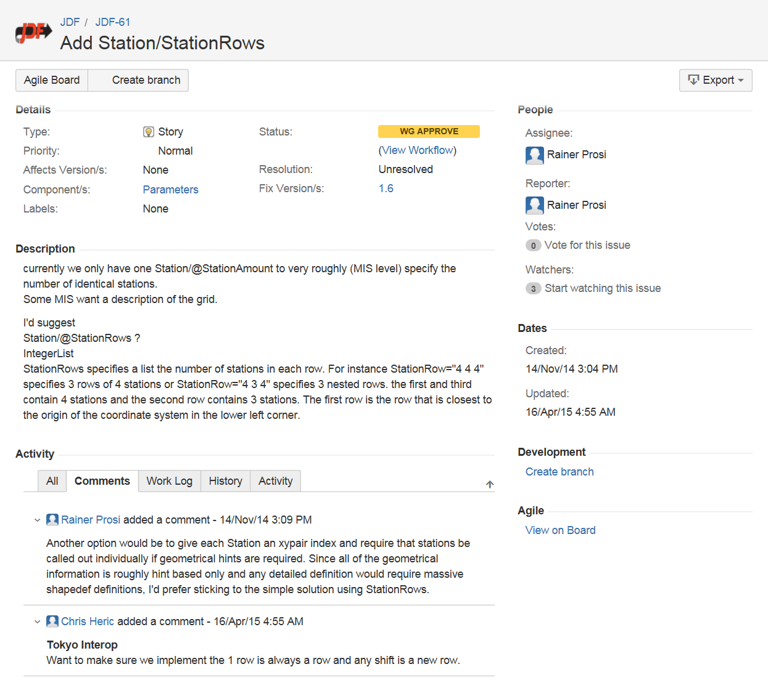
Discussions
You can take part the discussions by writing comments to the individual Issues.

Slide 8
Workgroup Revision
When discussion is completed, the appropriate CIP4 Workgroup revise the issue.

Slide 9
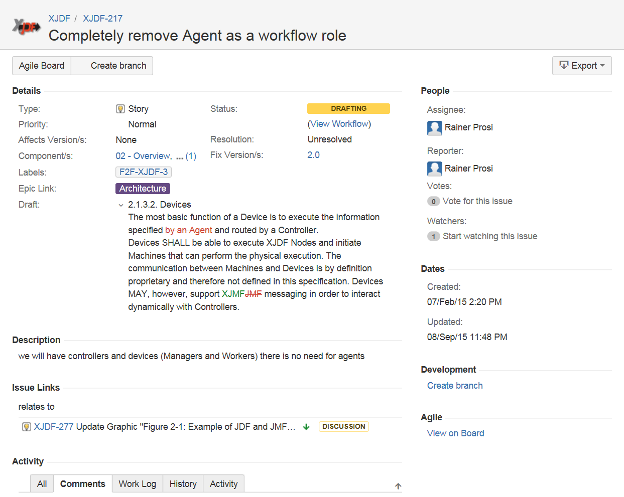
Drafting
Drafting of all Specification changes needed related to the appropriate issue.

Slide 10
Implementation
Update of the CIP4 Specification AND the Specifications XML Schema

Slide 11
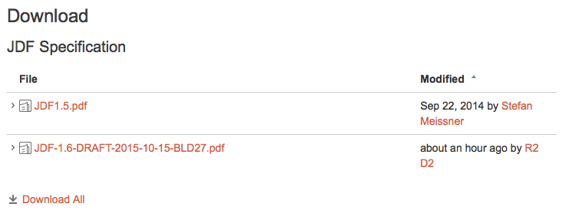
Continuous Builds
https://confluence.cip4.org/display/PUB/JDF
https://confluence.cip4.org/display/PUB/XJDF
You can always find the latest DARFT Version of a Spec on Confluence.

Slide 12
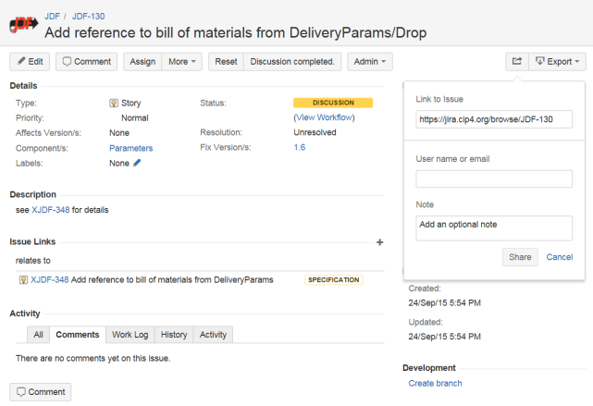
JIRA Tips and Tricks
Share Issue
1
Click „Share“-Button
2
Email Address
3
Share
You can share each issue with any person you want per Email.

Slide 13
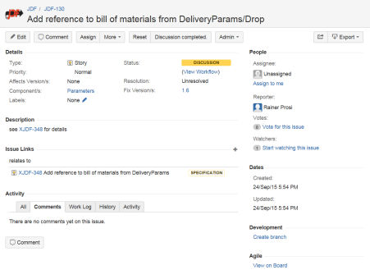
JIRA Tips and Tricks
Vote for a Issue
You can raise the priority of an Issue by voting.
Watch / Unwatch Issue
You can subscribe or unsubscribe to all changes of an Issue by watching or unwatching.

Slide 14
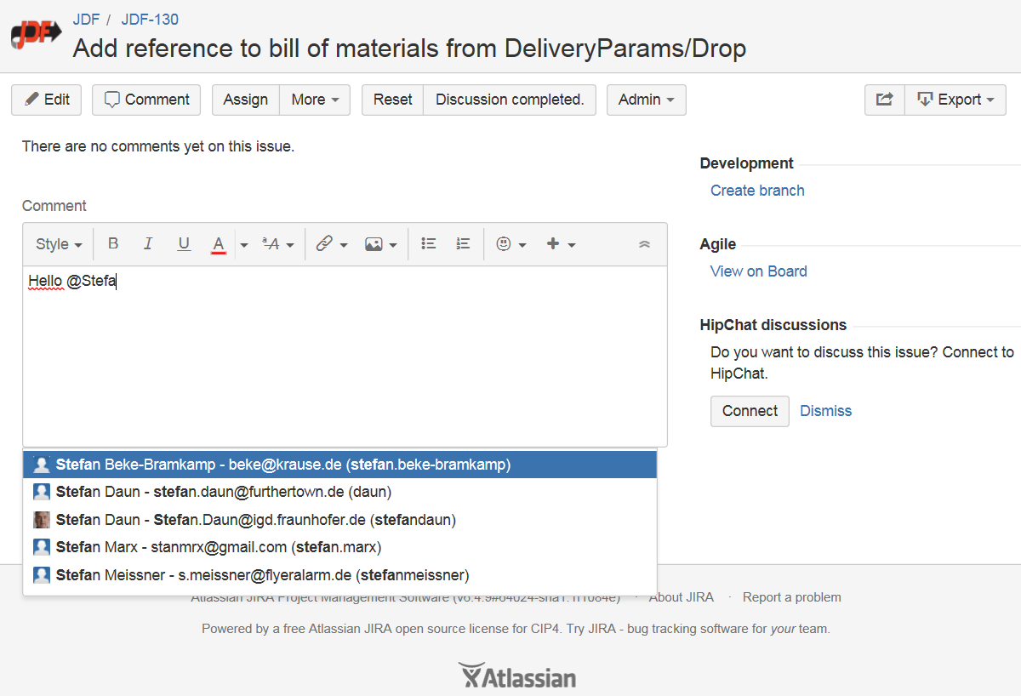
JIRA Tips and Tricks
Adressing Peoples
1
Start typing „@....“ (here: „@Stefa“)
2
Filtered Listbox of Users
You can address CIP4 Members and Visitors directly at any point by typing “@” plus the appropriate Name (here: “Stefa”). When start typing, a listbox appears where you can find a filtered list of users.

