Slide 1


CIP4 and JDF: 15 years dedicated to graphic industries workflow automation
Dr. Rainer Prosi
Notes:
3/9/2016

Slide 2
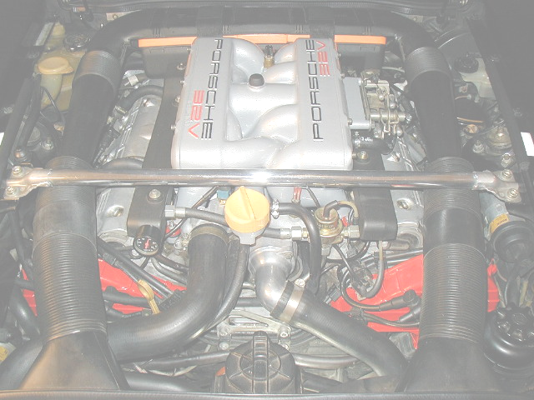
What you do not need to know about JDF¹
<JDF ID="n1" Status="Waiting" Type=“Product" Version="1.2“/>
<ResourcePool>
<Layout Class="Parameter" ID="r112" Status="Unavailable">
<Signature>
<Sheet SurfaceContentsBox="0 0 1842.5197 1417.3228">
<Surface Side="Front">
<MarkObject CTM="1 0 0 1 42 66" Ord="0"/>
%PDF-1.3
%âãÏÓ
1 0 obj <</Type /Page /Parent 9 0 R /Resources 3 0 R /Contents 2 0 R
/BleedBox [ 0 0 635 881 ] /TrimBox [ 0 0 627 873 ] /Thumb 37 0 R >>
endobj
2 0 obj<</Length 698 /Filter /FlateDecode>>
stream
H‰ìSMk1ýþ:¦‡q,Ëöxzk6H¡ì„B(aºùêîB³¡ÿ¾’å™@sï!büÞÓ³4úmžÀx‚œ=
1 - unless you are a JDF developer

Slide 3
JDF Technology on One Slide
JDF is a Graphic Arts Job Ticket
Data Interchange Format Specification
- JDF is not an Application or System
JDF allows systems to Communicate
JDF is encoded in XML
Content is referenced, not embedded
JDF is extensible
Notes:
3

Slide 4
JDF on Another 2 Slides
- Goals and Requirements -
Why JDF?
  Automation increases Efficiency
  Digital information reduces errors compared to paper job jackets
  Information allows for informed decisions
Notes:
4

Slide 5
JDF on Another 2 Slides
- Goals and Requirements -
What does JDF enable?
  Setup a Job in the graphic arts from the view point of:
    Technical Applications
    Management Information Systems
    Customers
  Collect data that is relevant to a Job from origination to delivery
    Business Data
    Technical Data
Realtime Job Tracking
Comprehensively describe many areas of the graphic arts
Notes:
5

Slide 6
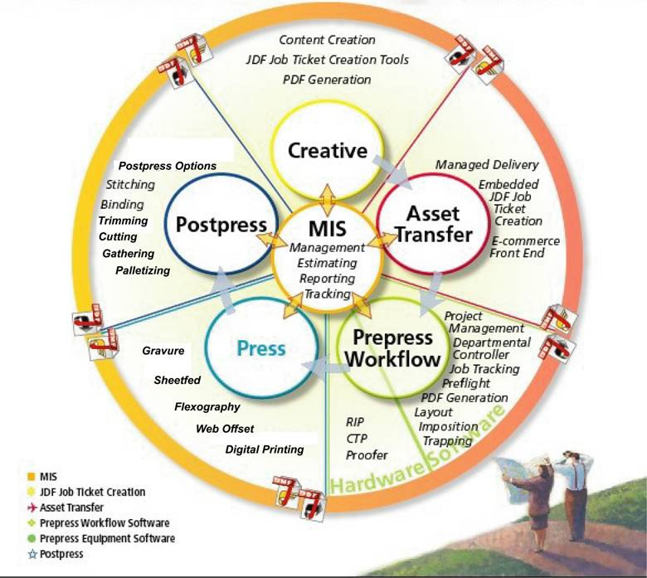
JDF
in the
workflow
Postpress
&
Delivery

Slide 7





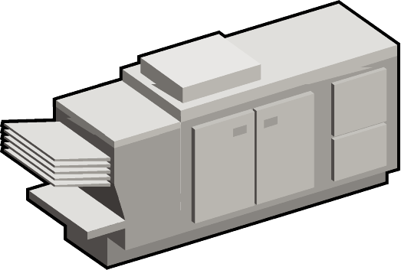
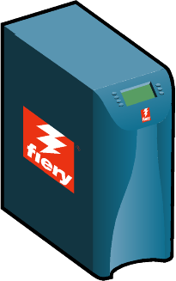
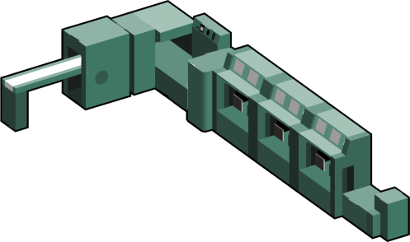
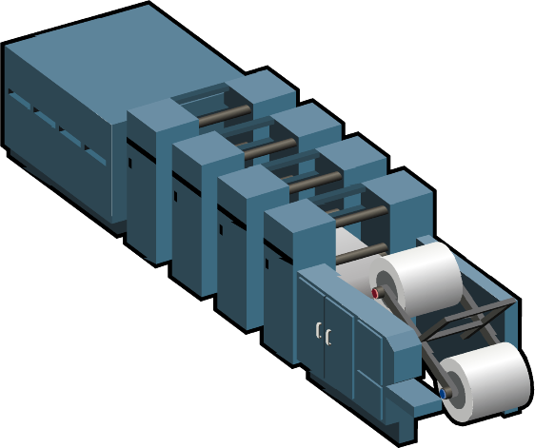
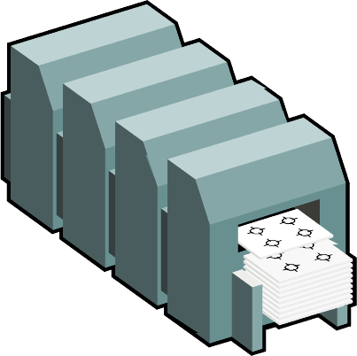

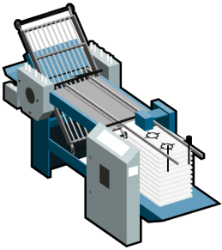
MIS Communication with JDF
MIS passes data it knows to JDF-enabled production systems
JDF-enabled production systems can add more data to the JDF ticket
  Production parameters
  Costing data
  General notes
JDF ticket passed back to MIS
Bridges the islands of information
MIS

Slide 8

JMF Messaging
Semi Real-time data interchange format
  Small XML structures
  Network Data (HTTP)
  Used for:
    Snapshots of Job / Device status
    Dynamic job update (Change Orders)
    Job submission and queue scheduling
Notes:
8
Small XML structures
JDF is referenced via URL, not bound into message
Idea is to minimize network traffic and delay transmission of data until it is actually needed
Send potentially interesting information as soon as it is available

Slide 9

Customer requirements for JDF
Customers can be either End Customer or business partner!
Describe the final product or the requested service
Details may vary in detail from very rough to very detailed
Allow price and contract negotiations
Job Tracking
Manage the approval cycle
Change order Management

Slide 10
PrintTalk
Format to specify the context of a JDF in a business transaction
  JDF describes the product to be produced
  PrintTalk describes the business
  context of the JDF product
    Request For Quote
    Quotation
    Purchase Order
    Invoice
    Change Order
  PrintTalk also contains Pricing Information

Slide 11
JDF Complete Job Ticket
JDF describes the entire Production in one File
  JDF Descibes Process interdependencies
    All processes are described in one single Job Ticket
Notes:
11

Slide 12

XJDF – New Developments
XJDF is a simplified version of JFD
  Point to Point interactions only
  Easier to understand and implement
  Closely aligned with new developments in XML Technologies
Notes:
12

Slide 13


JDF/XJDF in PDF metadata
JDF/XJDF is being used as the semantic basis for an Interoperability Conformance Specification (ICS) to define transport of product intent with PDF:
    Metadata may vary depending on page and/or document
    Media selection
    Finishing options
    Recipient data
    …
Collaborative effort with ISO TC130 TF2/WG3

Slide 14
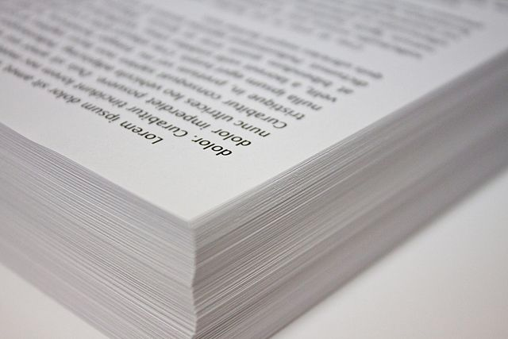
What does PDF represent today?
  Digital Film
  Description of printed Pages
    Colors
    Fonts
    Trim Boxes
    …
  Global metadata in a document context (Author, Customer)
Page description language
Notes:
14

Slide 15
What does PDF NOT represent today?
  Description of Media properties
  Binding
  Page layout (simplex, duplex…)
  …
No Product description language
  Products may be described with JDF
Notes:
15

Slide 16
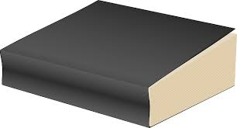
Why Metadata in PDF?
  Applying Metadata to page ranges
  Variable data / PDF/VT
    Variable Metadata
      Paper for the Cover
      Different paper for the body
      Localized page binding
  Product and page description in one single file
Product description language
Notes:
16

Slide 17
Which Metadata in PDF?
  Only product details that are known to the customer/producer of the pdf.
  Independent of production process.
  Based on: JDF Product Intent
  Encoding: PDF (NOT XML)
No Process description language
Preview version:
https://confluence.cip4.org/display/PUB/ICS-CommonMetadata.PDF.1.5
Notes:
17

Slide 18
Applications of PDF Metadata
  Loose coupling of variable data generation and print.
  Complete description of simple products for online print procurement (excluding amounts)
  Extended „Preflight“ including finishing requirements
  …
Notes:
18

