Slide 1
ICS Authoring with HTML
Authoring ICS using HTML

Slide 2
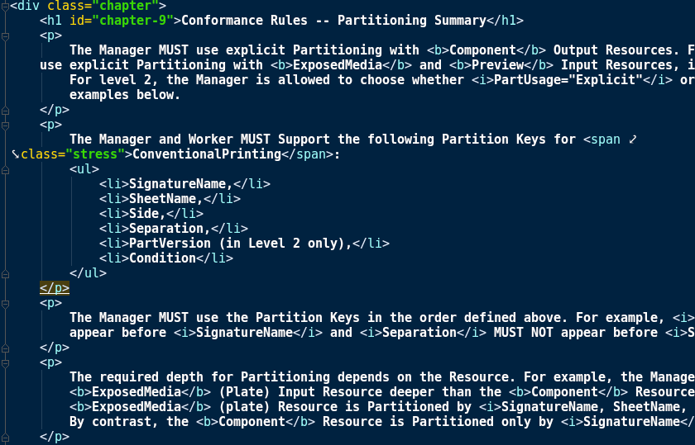
HTML is well known among developers and can be useful for authoring Interoperability Conformance
Specifications (ICS). It...
is easy to format with CSS
is convertible to PDF
can be shared between teams

Slide 3
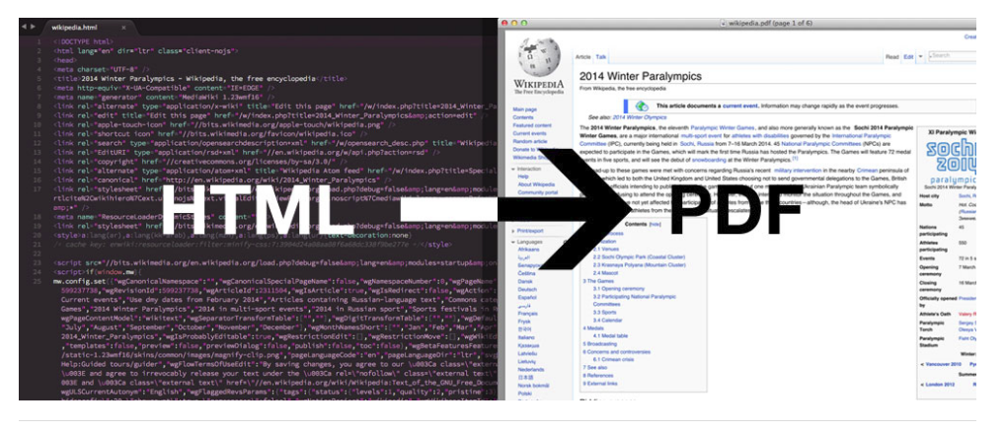
Converting HTML to PDF
Several open source tools are available
for converting HTML files to PDF. Here, wkhtmltopdf was used to convert an HTML prototype of an ICS to a PDF.

Slide 4
Converting HTML to PDF
wkhtmltopdf (and wkhtmltoimage) are open source command line tools for converting HTML into PDF and various image formats using the Qt WebKit rendering engine.

Slide 5
Converting HTML to PDF
wkhtmltopdf is like other command-line tools- basic usage is
wkhtmltopdf <options> <file.html> <file.pdf>

Slide 6
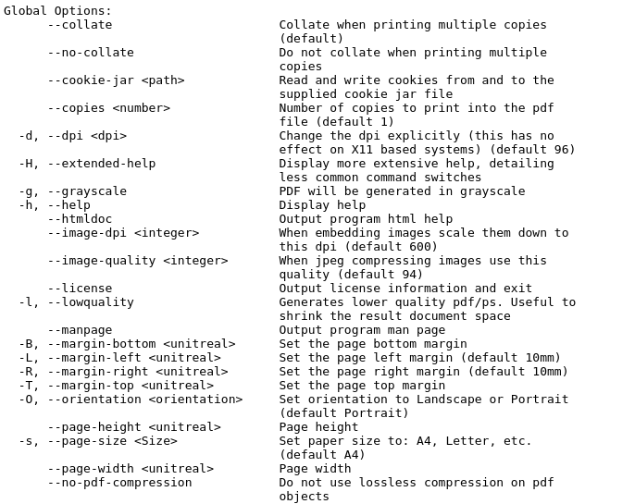
Converting HTML to PDF
wkhtmltopdf has several options that could be useful when authoring ICS
global options
outline options

Slide 7
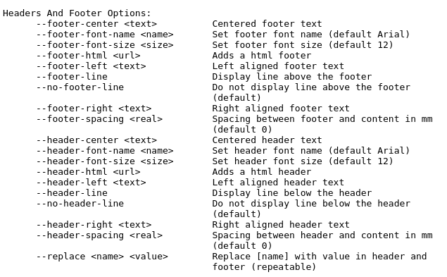
Converting HTML to PDF
wkhtmltopdf has a several options that could be useful when authoring ICS:
global options
outline options
header/footer options
table of content (TOC) options

Slide 8
Converting HTML to PDF
In particular, the options
footer-html
header-html
xsl-style-sheet
allow an author to use custom html footers and headers (compatible with CSS & JS), as well as custom TOCs.

Slide 9
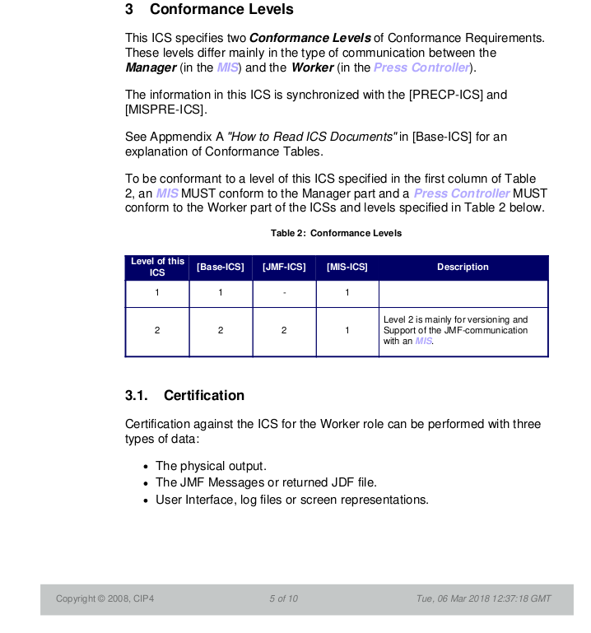
Sample page from a PDF converted from HTML

Slide 10
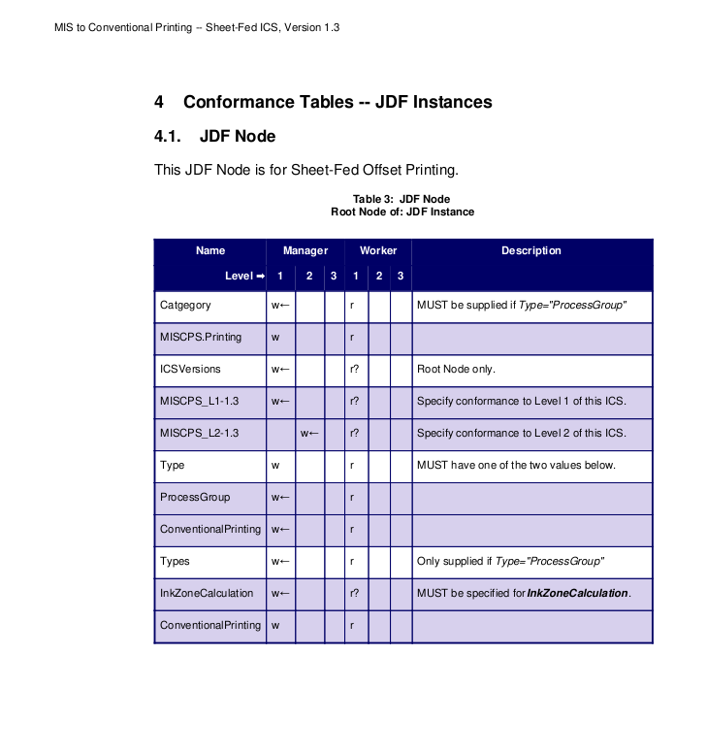
Sample page with a complete table

Slide 11
Authoring ICS with HTML

